Slide 2
Topics
Introduction to File Input and Output
Open, Read/Write and Close a file
Using Loops to Process Files
Using the with Statement to Open Files
Exception handling

Slide 3
Introduction to File Input and Output
For program to retain data between the times it is run, you must save the data
  Data is saved to a file, typically on computer disk
  Saved data can be retrieved and used at a later time
Three steps when a program uses a file
  Open the file
  Process the file
  Close the file

Slide 4
Types of Files and File Access Methods
In general, two types of files
  Text file: contains data that has been encoded as text using schemes like ASCII or Unicode
  Binary file: contains data that has not been converted to text, intended only for a program to read
  We will only be working with text files in this class
Two ways to access data stored in file
  Sequential access: file read sequentially from beginning to end, can’t skip ahead
  Direct access (or random acess): can jump directly to any piece of data in the file
  We will be using sequential access in this class.

Slide 5
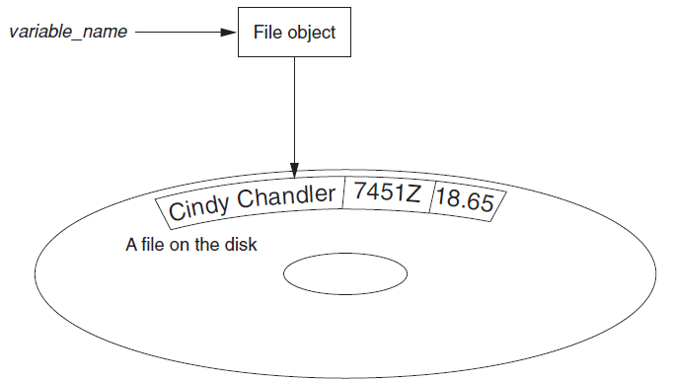
File Objects
In order for a program to work with a file, the program must create a file object in memory.
A file object is an object that is associated with a specific file and provides a way for the program to work with that file.
In the program, a variable references the file object.
This variable is used to carry out any operations that are performed on the file.

Slide 6
Opening a File
open function: used to open a file
  Creates a file object and associates it with a file
  General format:
  file_variable = open(filename, mode)
Mode: string specifying how the file will be opened
  Example: reading only ('r'), writing ('w'), and appending ('a’)
  There are more modes, but we will only use one of the above in this class.

Slide 7
Opening a File
If open function receives a filename that does not contain a path, it assumes that the file is in same directory as Python program
  outfile1 = open(‘test1.txt', 'w’)

Slide 8
Opening a File
You can specify alternative path and file name in the open function using one of the following:
  Natively, Windows file path employs the backslash "\“. Python lets you use OS-X/Linux style slashes "/" even in Windows. Therefore, you can refer to the file as:
  outfile = open('C:/Users/ankur/OneDrive/Desktop/philosophers.txt', 'w')
  If using backslash, because it is a special character in Python, you must remember to escape every instance:
  outfile = open('C:\\Users\\ankur\\OneDrive\\Desktop\\philosophers.txt', 'w')'
  Alternatively, you can prefix the entire file name string with the rawstring marker ‘r’. That way, everything in the string is interpreted as a literal character, and you don't have to escape every backslash.
  outfile = open(r'C:\Users\ankur\OneDrive\Desktop\philosophers.txt', 'w')
In all the cases above, if the file does not already exist, a file is created.

Slide 9
Writing Data to a File
File object’s write method is used to write data to the file. Note that the file must be opened for writing (using the 'w' or 'a' mode) or an error will occur.
  Format: file_variable.write(string)
  test_file2.write(‘Manhattan Colelge’)
File should be closed after working with the file using file object’s close method
  Format: file_variable.close()
  test_file2.close()

Slide 10
Writing Data to a File
def main():
# Open a file named philosophers.txt.
outfile = open('philosophers.txt', 'w')
# Write the names of three philosphers
outfile.write('John Locke\n')
outfile.write('David Hume\n')
outfile.write('Edmund Burke\n')
# Close the file.
outfile.close()
# Call the main function.
if __name__ == '__main__':
main()

Slide 11
Reading Data From a File
The read method can be used to read the entire content of a file as a string, if the file has been opened for reading using the ‘r’ mode.
def main():
# Open the file.
infile = open('philosophers.txt', 'r')
# Read the file's contents.
file_contents = infile.read()
# Close the file.
infile.close()
# Print the data that was read
print(file_contents)
# Call the main function.
if __name__ == '__main__':
main()

Slide 12
Reading Data From a File
Although the read method allows you to easily read the entire contents of a file with one statement, many programs need to read and process the items that are stored in a file one at a time.
In Python, you can use the readline method to read a line from a file.
  A line is simply a string of characters that are terminated with a \n.
  The method returns the line as a string, including the \n.

Slide 13

Reading Data From a File
def main():
# Open a file.
infile = open('philosophers.txt', 'r')
# Read the lines from the file
line1 = infile.readline()
line2 = infile.readline()
line3 = infile.readline()
# Close the file.
infile.close()
# Print the data that was read.
print(line1)
print(line2)
print(line3)
# Call the main function.
if __name__ == '__main__':
main()

Slide 14
Reading Data From a File
You will notice in the output of the previous program that a blank line is printed after each line of output.
This is because each of the strings that are printed in end with a \n escape sequence which cause an extra blank line to appear.
You can use the rstrip method to remove, or “strip,” specific characters from the end of a string.
In the previous example, replace the three print statements with:
  print(line1.rstrip('\n'))
  print(line2.rstrip('\n'))
  print(line3.rstrip('\n'))

Slide 15
Appending Data to an Existing File
When open file with 'w' mode, if the file already exists it is overwritten
To append data to a file, use the 'a' mode
  If file exists, it is not erased, and if it does not exist it is created
  Data is written to the file at the end of the current contents
Example:
  myfile = open('philosophers.txt', 'a')
  myfile.write('Pythagoras')
  myfile.close()

Slide 16
Writing and Reading Numeric Data
Numbers must be converted to strings before they are written to a file.
  Python has a built-in function named str that converts a value to a string.
Number are read from a text file as strings and can be converted to numeric type using int or float.
  Note that both the int and float functions ignore any \n at the end of the string that is passed as an argument.

Slide 17
Writing and Reading Numeric Data
# Write to a file
def main():
# Open a file for writing.
outfile = open('numbers.txt', 'w')
# Get three numbers from the user.
num1 = int(input('Enter a number: '))
num2 = int(input('Enter another number: '))
num3 = int(input('Enter another number: '))
# Write the numbers to the file.
outfile.write(str(num1) + '\n')
outfile.write(str(num2) + '\n')
outfile.write(str(num3) + '\n')
# Close the file.
outfile.close()
print('Data written to numbers.txt')
# Call the main function.
if __name__ == '__main__':
main()
# Read from a file
def main():
# Open a file for reading.
infile = open('numbers.txt', 'r')
# Read three numbers from the file.
num1 = int(infile.readline())
num2 = int(infile.readline())
num3 = int(infile.readline())
# Close the file.
infile.close()
# Add the three numbers.
total = num1 + num2 + num3
# Display the numbers and their total.
print(f'The numbers are: {num1}, {num2}, {num3}')
print(f'Their total is: {total}')
# Call the main function.
if __name__ == '__main__':
main()

Slide 18
Using Loops to Process Files
Files usually hold large amounts of data, and programs typically use a loop to process the data in a file.
Also, a program may not now the number of items that are to be processed.
  So, you need a way of knowing when the end of the file has been reached.
In Python, the readline method returns an empty string ('') when it has attempted to read beyond the end of a file.
  This makes it possible to write a while loop that determines when the end of a file has been reached.
  while line != ''

Slide 19
Using while loops to Process Files
def main():
# Open a file for reading.
infile = open('numbers.txt', 'r')
total = 0
# Read the first line from the file.
line = infile.readline()
# Use the loop as long as
# an empty string is not returned
while line != '':
num = int(line)
total = total + num
line = infile.readline()
# Close the file.
infile.close()
# Display the total.
print(f'The total is: {total}')
# Call the main function.
if __name__ == '__main__':
main()

Slide 20
Using for Loop to Read Lines
Python allows the programmer to write a for loop that automatically reads lines in a file and stops when end of file is reached.
  Format: for line in file_object:
  statements
  The loop iterates once over each line in the file

Slide 21
Using for Loop to Read Lines
def main():
# Open a file for reading.
infile = open('numbers.txt', 'r')
total = 0
# Read all the lines from the file.
for line in infile:
num = int(line)
total = total + num
# Close the file.
infile.close()
# Display the total.
print(f'The total is: {total}')
# Call the main function.
if __name__ == '__main__':
main()

Slide 22
Using the with Statement to Open Files
It is important that a program closes all the files that it has opened. If you use the with statement to open a file, the file will automatically be closed when the program is finished using the file.
General format:
  filename is a string specifying the name of the file
  mode is a string specifying the mode, such as 'r', 'w', or 'a'
  file_variable is the name of the variable that will reference the file object
with open(filename, mode) as file_variable:
statement
statement
etc.

Slide 23
Using the with Statement to Open Files
def main():
total = 0
with open('numbers.txt', 'r') as infile:
for line in infile:
num = int(line)
total = total + num
print(f'The total is: {total}')
# Call the main function.
if __name__ == '__main__':
main()

Slide 24
Using the with Statement to Open Files
Opening multiple files with a with statement:
This example opens a file named file1.txt for reading, and a file named file2.txt for writing.
Code inside the with suite can use input_file to read data from file1.txt and output_file to write data to file2.txt.
When the code inside the with suite has finished, both files are automatically closed.
with open('file1.txt', 'r') as input_file,
open('file2.txt', 'w') as output_file:
statement
statement
etc.

Slide 25
Using the with Statement to Open Files
# This program makes a copy of numbers.txt file.
def main():
with open('numbers.txt', 'r') as infile, open('numbers_copy.txt', 'w') as outfile:
line = infile.read()
while line != '':
outfile.write(f'{line}')
line = infile.read()
print('The file has been copied.')
# Call the main function.
if __name__ == '__main__':
main()

Slide 26
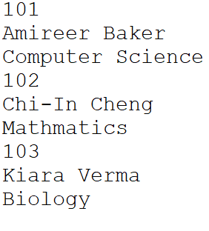
Modifying Records in a File
Let’s say that we have a student.txt file that holds records for three students as shown in the figure.
Each student record includes their id, name and department.
You need to write a program that can be used to modify the department field of an existing student.

Slide 27
Modifying Records in a File
To modify a record in a sequential file, you must create a second temporary file.
You copy all of the original file’s records to the temporary file, but when you get to the record that is to be modified, you do not write its old contents to the temporary file.
Instead, you write its new modified values to the temporary file.
Then, you finish copying any remaining records from the original file to the temporary file.
The temporary file then takes the place of the original file.
You delete the original file and rename the temporary file, giving it the name that the original file had on the computer’s disk.

Slide 28
Modifying Records in a File
The Python standard library’s os module provides a function named remove, that deletes a file on the disk.
  You simply pass the name of the file as an argument to the function.
  os.remove(‘student.txt')
The os module also provides a function named rename, that renames a file.
  os.rename('temp.txt’, ‘student.txt')

Slide 29
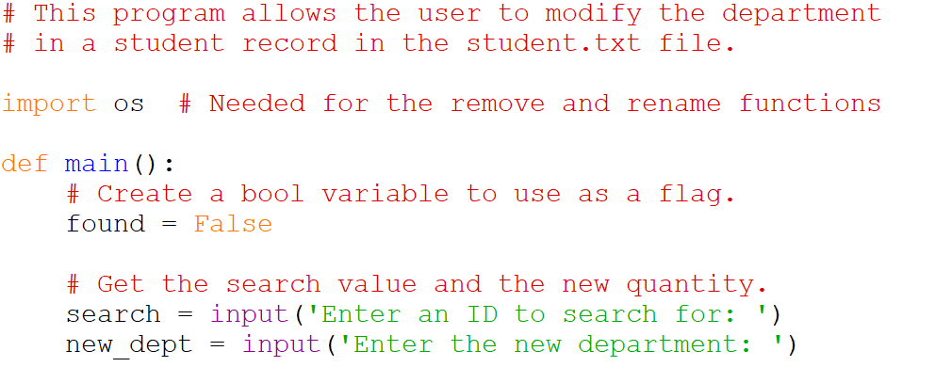
Modifying Records in a File

Slide 30
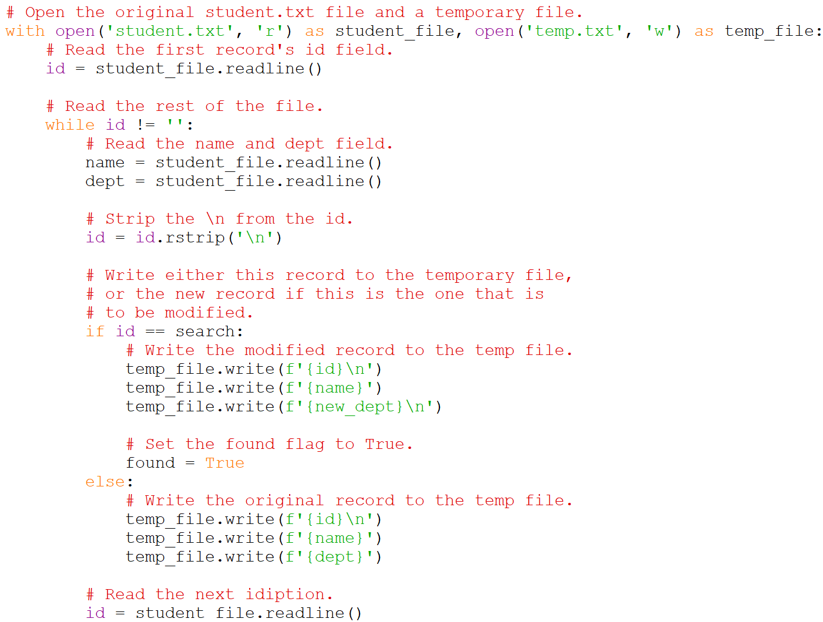
Modifying Records in a File

Slide 31
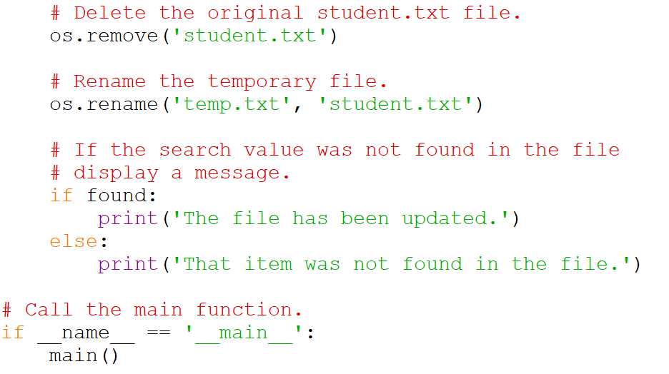
Modifying Records in a File

Slide 32
Modifying Records in a File
# This program allows the user to modify the department
# in a student record in the student.txt file.
import os # Needed for the remove and rename functions
def main():
# Create a bool variable to use as a flag.
found = False
# Get the search value and the new quantity.
search = input('Enter an ID to search for: ')
new_dept = input('Enter the new department: ')
# Open the original student.txt file and a temporary file.
with open('student.txt', 'r') as student_file, open('temp.txt', 'w') as temp_file:
# Read the first record's id field.
id = student_file.readline()
# Read the rest of the file.
while id != '':
# Read the name and dept field.
name = student_file.readline()
dept = student_file.readline()
# Strip the \n from the id.
id = id.rstrip('\n')
# Write either this record to the temporary file,
# or the new record if this is the one that is
# to be modified.
if id == search:
# Write the modified record to the temp file.
temp_file.write(f'{id}\n')
temp_file.write(f'{name}')
temp_file.write(f'{new_dept}\n')
# Set the found flag to True.
found = True
else:
# Write the original record to the temp file.
temp_file.write(f'{id}\n')
temp_file.write(f'{name}')
temp_file.write(f'{dept}')
# Read the next idiption.
id = student_file.readline()
# Delete the original student.txt file.
os.remove('student.txt')
# Rename the temporary file.
os.rename('temp.txt', 'student.txt')
# If the search value was not found in the file
# display a message.
if found:
print('The file has been updated.')
else:
print('That item was not found in the file.')
# Call the main function.
if __name__ == '__main__':
main()
The entire code from the previous three slides.
Make sure that you have a text file student.txt with some student records as shown below.

Slide 33
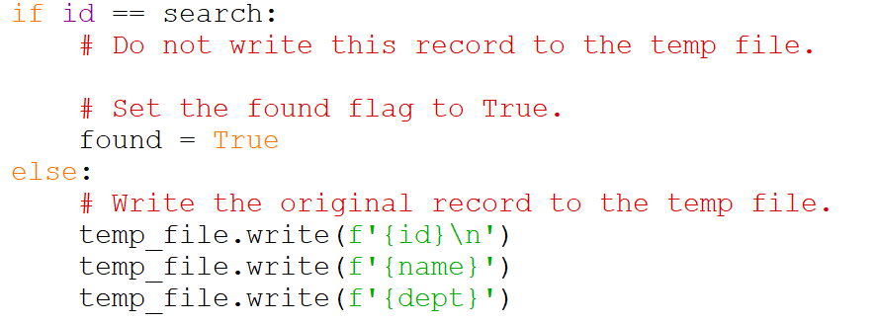
Deleting Records in a File
Deleting a record follows a process similar to modifying a record.
Instead of writing the modified record to the new file, you just don’t write this record to the new file as shown in the if block below.

Slide 34
Exceptions
An exception is an error that occurs while a program is running, causing the program to abruptly halt.
You can use the try/except statement to gracefully handle exceptions.

Slide 35
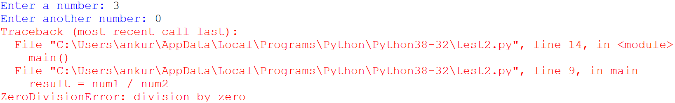
Exceptions
# This program divides a number by another number.
def main():
# Get two numbers.
num1 = int(input('Enter a number: '))
num2 = int(input('Enter another number: '))
# Divide num1 by num2 and display the result.
result = num1 / num2
print(f'{num1} divided by {num2} is {result}')
# Call the main function.
if __name__ == '__main__':
main()

Slide 36
Exceptions
You can prevent many exceptions from being raised by carefully coding your program.
In the previous program, rather than allowing the exception to be raised, we can test the value of num2, and display an error message if the value is 0.
This is an example of gracefully avoiding an exception.

Slide 37
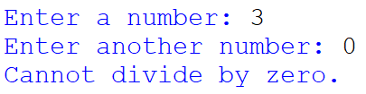
Exceptions
# This program divides a number by another number.
def main():
num1 = int(input('Enter a number: '))
num2 = int(input('Enter another number: '))
# If num2 is zero, display error message.
if num2 != 0:
result = num1 / num2
print(f'{num1} divided by {num2} is {result}')
else:
print('Cannot divide by zero.')
# Call the main function.
if __name__ == '__main__':
main()

Slide 38
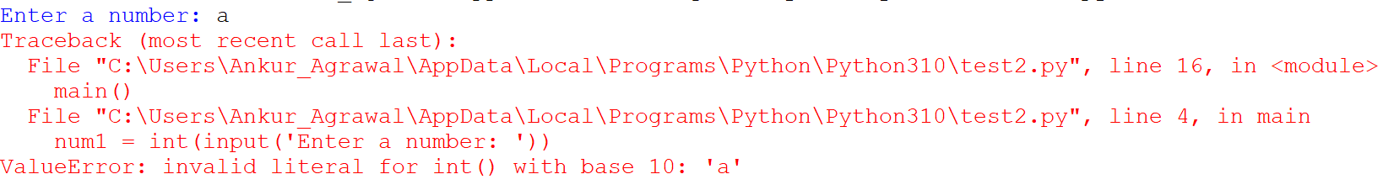
Exceptions
Some exceptions cannot be avoided regardless of how carefully you write your program.
# This program divides a number by another number.
def main():
num1 = int(input('Enter a number: '))
num2 = int(input('Enter another number: '))
# If num2 is zero, display error message.
if num2 != 0:
result = num1 / num2
print(f'{num1} divided by {num2} is {result}')
else:
print('Cannot divide by zero.')
# Call the main function.
if __name__ == '__main__':
main()
The program raises an exception called ValueError with the description as shown.

Slide 39
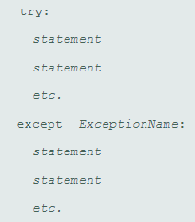
Exceptions
Python allows you to write code that responds to exceptions when they are raised and prevents the program from abruptly crashing.
Such code is called an exception handler and is written with the try/except statement.
If a statement in the try block raises an exception that is specified by the ExceptionName in an except clause, then the handler that immediately follows the except clause executes. Then, the program resumes execution with the statement immediately following the try/except statement.
If a statement in the try block raises an exception that is not specified by the ExceptionName in an except clause, then the program will halt with a traceback error message.
If the statements in the try block execute without raising an exception, then the except clauses and handlers are skipped, and the program resumes execution with the statement immediately following the try/except statement.

Slide 40

Exceptions
# This program divides a number by another number.
def main():
try:
num1 = int(input('Enter a number: '))
num2 = int(input('Enter another number: '))
result = num1 / num2
print(f'{num1} divided by {num2} is {result}')
except ValueError:
print('Error: Please enter a numeric value.')
# Call the main function.
if __name__ == '__main__':
main()

Slide 41
Exceptions – Default Error Message
You can also display an exception’s default error message (the same error message that you see displayed at the end of a traceback when an exception goes unhandled.)
When an exception is thrown, an object known as an exception object is created in memory. The exception object usually contains a default error message pertaining to the exception.
When you write an except clause, you can optionally assign the exception object to a variable, as shown here:
  except ValueError as err:
  There is nothing special about the name err. You can use any name that you wish.
You can pass the err variable to the print function to display the default error message that Python provides for that type of error.

Slide 42
Exceptions – Default Error Message
Displaying an Exception’s Default Error Message
# This program divides a number by another number.
def main():
try:
num1 = int(input('Enter a number: '))
num2 = int(input('Enter another number: '))
result = num1 / num2
print(f'{num1} divided by {num2} is {result}')
except ValueError as err:
print(err)
# Call the main function.
if __name__ == '__main__':
main()

Slide 43
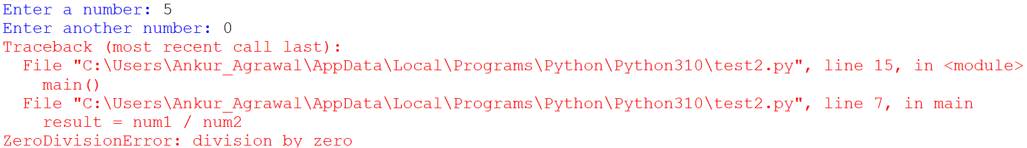
Exceptions
What happens when you enter 0 as the denominator?
# This program divides a number by another number.
def main():
try:
num1 = int(input('Enter a number: '))
num2 = int(input('Enter another number: '))
result = num1 / num2
print(f'{num1} divided by {num2} is {result}')
except ValueError:
print('Error: Please enter a numeric value.’)
# Call the main function.
if __name__ == '__main__':
main()

Slide 44

Handling Multiple Exceptions
You can add another except clause to handle the ZeroDivisionError exception.
# This program divides a number by another number.
def main():
try:
num1 = int(input('Enter a number: '))
num2 = int(input('Enter another number: '))
result = num1 / num2
print(f'{num1} divided by {num2} is {result}')
except ValueError:
print('Error: Please enter a numeric value.')
except ZeroDivisionError:
print('Error: Please enter a non-zero denominator.')
# Call the main function.
if __name__ == '__main__':
main()

Slide 45
Handling Multiple Exceptions
An except clause that does not list a specific exception will handle any exception that is raised in the try block
  Should always be last in a series of except clauses
The next program reads a file sales_data.txt where each line represents a sales value. This program handles multiple exceptions including:
  IOError – In case of a missing file
  ValueError – In case of a non-integer value in the file
  The final except clause handles all other exceptions

Slide 46
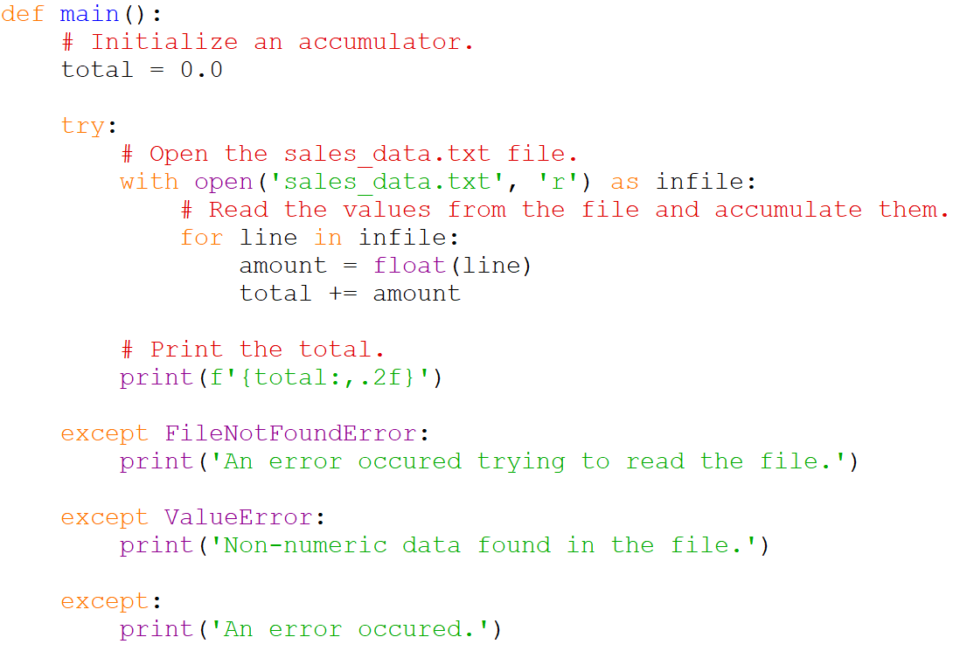
Handling Multiple Exceptions

Slide 47
Handling Multiple Exceptions
# This program displays the total of the
# amounts in the sales_data.txt file.
def main():
# Initialize an accumulator.
total = 0.0
try:
# Open the sales_data.txt file.
with open('sales_data.txt', 'r') as infile:
# Read the values from the file and accumulate them.
for line in infile:
amount = float(line)
total += amount
# Print the total.
print(f'{total:,.2f}')
except FileNotFoundError:
print('An error occurred trying to read the file.')
except ValueError:
print('Non-numeric data found in the file.')
except:
print('An error occurred.')
# Call the main function.
if __name__ == '__main__':
main()
Entire code for the previous example.
Note that the third except clause can catch all exceptions that are otherwise not specified in other except clauses.

Slide 48
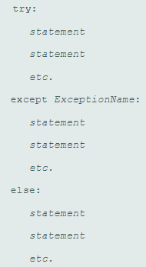
The else Clause
The try/except statement may have an optional else clause, which appears after all the except clauses.
The statements in the else block are executed after the statements in the try block, only if no exceptions were raised.
If an exception is raised, the else block is skipped.

Slide 49
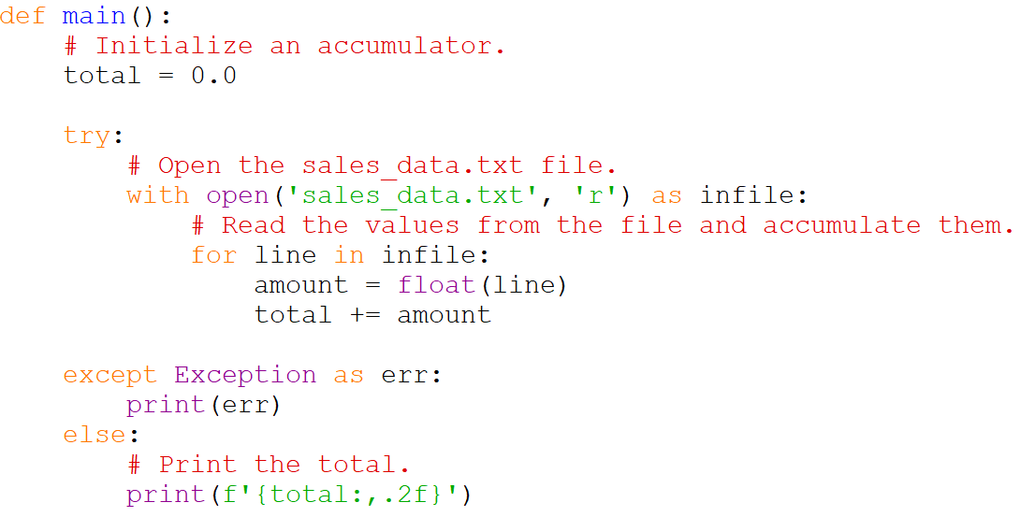
The else Clause
Below, the code in the else block is executed and the total displayed only if the statements in the try block execute without raising an exception.

Slide 50
The else Clause
Entire code for the previous example
# This program displays the total of the
# amounts in the sales_data.txt file.
def main():
# Initialize an accumulator.
total = 0.0
try:
# Open the sales_data.txt file.
with open('sales_data.txt', 'r') as infile:
# Read the values from the file and accumulate them.
for line in infile:
amount = float(line)
total += amount
except Exception as err:
print(err)
else:
# Print the total.
print(f'{total:,.2f}')
# Call the main function.
if __name__ == '__main__':
main()

Slide 51
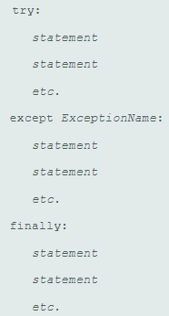
The finally Clause
The try/except statement may have an optional finally clause, which must appear after all the except clauses (and the optional else clause).
The statements in the finally block are always executed whether an exception occurs or not.
The purpose of the finally block is to perform cleanup operations, such as closing files or other resources.

Slide 52
Exception Types
There are many different types of exceptions that can occur in a Python program.
When you are designing try/except statements, one way you can learn about the exceptions that you need to handle is to consult the Python documentation. It gives detailed information about each possible exception and the types of errors that can cause them to occur.
Another way that you can learn about the exceptions that can occur in a program is through experimentation. You can run a program and deliberately perform actions that will cause errors. By watching the traceback error messages that are displayed, you will see the names of the exceptions that are raised. You can then write except clauses to handle these exceptions.

Slide 53
Summary
This chapter covered:
  Types of files and file access methods
  Filenames and file objects
  Writing data to a file
  Reading data from a file and determining when the end of the file is reached
  Processing records
  Exceptions handling

